Slide 1
Chapter 6: CYBER SECURITY AND RISK ANALYSIS
TS. DR. ROZI NOR HAIZAN
BINTI NOR

Slide 2
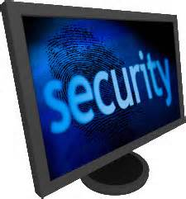
OBJECTIVES
To define computer security
To differentiate between aspect of computer security
To know hacking and hacker ethic
To describe various threats to computer security
To describe security
countermeasures

Slide 3
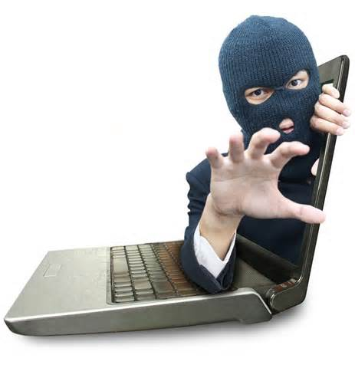
contents
Introduction
Defining computer security
Three distinct aspects of computer security
Knowing computer hackers
Threats to computer security
Security countermeasures

Slide 4
Introduction
Computers getting faster and less expensive
Utility of computers increasing
Email
Web surfing
Shopping
Managing personal information
Increasing use of computers → growing importance of computer security
Computer security/IT security/ Cyber security is of utmost importance.

Slide 5
IT Security Incidents
Year
Number of Incidents Reported
2001
52,658
2000
21,756
1999
9,859
1998
3,734
1997
2,134
Source: CERT Web site at www.CERT.org/stats
Why computer incidents are so prevalent??
Notes:
1. Confidential personal identity data exposure
Credit Card information
Identity theft
2.Criminal activity/investigation
Online theft, fraud
Threatening communication
Child pornography
3. Denial of Service
Single or distributed (DoS or DDoS)
Inbound or outbound
4. Digital Millennium Copyright Act (DMCA) violation
Illegal distribution of copyrighted or licensed material (movies, music, software, games)
5. Malicious code activity
Worm, virus, Trojan

Slide 6
Defining Computer Security (1)
As applied to cyber technology, security can be thought of in terms of various measures designed to protect against:
unauthorized access to computer system
alteration of data that resides in and transmitted between computer system
disruption, vandalism, and sabotage of computer systems and networks

Slide 7
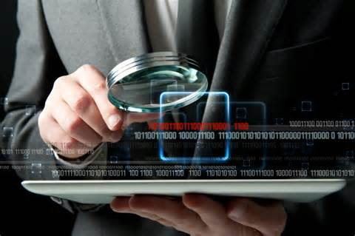
Defining Computer Security (2)
Garfinkel and Spafford (1996)
A computer is secure when two conditions are satisfied:
1) you can depend on it
2) its software behaves
as you expect

Slide 8
Defining Computer Security (3)
Kizza (1998)
Defines in terms of three elements:
Confidentiality: protect against unauthorized disclosure of information to third parties
Availability : prevents unauthorized withholding of information from those who need it when they need it
Integrity: prevents unauthorized modification of files

Slide 9

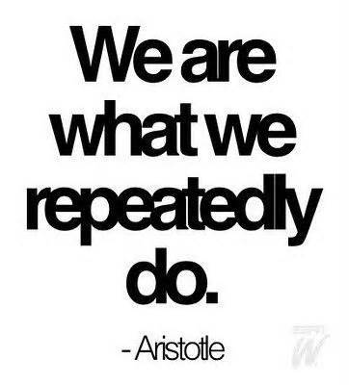
Defining Computer Security (4)
Spafford et. al (1989)
Consistency
Controlling access to resources

Slide 10
Three Aspects of Cyber security: Data, System, and Network Security
Security issues involving cyber technology span concerns having to do with three distinct kinds of vulnerabilities, which include:
unauthorized access to data, which either is resident in or exchanged between computer systems (i.e., data security);
attacks on system resources (such as computer hardware, operating system software, and application software) by malicious computer programs (i.e., system security);
attacks on computer networks, including the infrastructure of privately owned networks and the Internet itself (i.e., network security).

Slide 11
Data Security: Confidentiality, Integrity, and Availability of Information
Data security is concerned with vulnerabilities pertaining to unauthorized access to data that can either:
reside in one or more computer storage devices, or
be exchanged between two or more computer systems (transmitted data), or both.
Data-security issues affect the confidentiality, integrity, and availability of information.

Slide 12
Data Security (Cont.)
Richard Spinello (2000) describes what is required for data security by noting that:
…proprietary or sensitive information under one's custodial care is kept confidential and secure, that information being transmitted is not altered in form or content and cannot be read by unauthorized parties, and that all information being disseminated or otherwise made accessible through Web sites and on-line data repositories is as accessible and reliable as possible.

Slide 13
System Security
System security is concerned with vulnerabilities to system resources such as computer hardware, operating system software, and application software.
It is concerned with various kinds of viruses, worms, and related “malicious programs” that can disrupt and sometimes destroy computer systems.

Slide 14
System Security (Cont.)
Examples of malicious programs that have disrupted system security are the:
Internet Worm (1988);
ILOVEYOU Virus (2001);
Code Red Worm (2002);
Blaster virus (2004).
What are the differences between computer viruses and worms?

Slide 15
Network Security
Network security is concerned with securing computer networks – i.e., from privately owned computer networks (such as LANs and WANs) to the Internet itself – against various kinds of attacks.
The Internet’s infrastructure, which includes the set of protocols that makes communication across individual computer networks possible, has been the victim of several attacks.

Slide 16
Network Security (Cont.)
Attacks on computer networks have ranged from programs launched by individuals with malicious intentions to individuals who claimed their intentions were benign.
Some network attacks have severely disrupted activities on segments of the Internet.
In a few cases, these attacks have also rendered the Internet virtually inoperable.

Slide 17
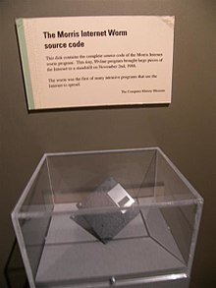
Network Security (Cont.)
In 1988, world realized for the first time just how vulnerable the Internet was to attacks.
Robert Morris unleashed a program, later described as the "Internet worm," that disabled much of the Internet.
Several Internet disruptions have since followed.
It is not always easy to determine whether a major computer network disruption is the result of malicious individuals or is due to the failure of some aspect of the network infrastructure itself.
e.g., was the significant power outage experienced by the AT&T long distance telephone service in 1990 was attributed to a software glitch in the system’s programming code that caused the network to crash or was it caused by “malicious” individuals?

Slide 18
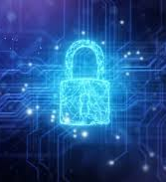
Hacking (1/3)
The Phases of Hacking
Phase One : the early years
1960s and 1970s
Originally, hacker referred to a creative programmer wrote clever code
The first operating systems and computer games were written by hackers
The term hacking was a positive term
Hackers were usually high-school and college students

Slide 19
Hacking (2/3)
Phase Two : Hacking takes on a more negative meaning
1970s and 1990s
Authors and media used the term hacker to describe someone who used computers, without authorization, sometimes to commit crimes
Early computer crimes were launched against business and government computers
Adult criminals began using computers to commit their crimes

Slide 20
Hacking (3/3)
Phase Three : the web era
Beginning in the mid-1990s
The increased use of the Internet for school, work, business transaction, and recreation makes it attractive to criminals with basic computer skill
Crimes include the release of malicious code
Unprotected computers can be used, unsuspectingly, to accomplish network disruption or commit fraud
Hackers with minimal computer skills can create havoc by using malicious code written by others

Slide 21
Hacker Ethic (1/5)
Steven Levy describe hacker ethics as :
Access to computers should be unlimited and total
All information should be free
Mistrust Authority – promote decentralization
Hackers should be judged by their hacking, not bogus criteria such as degrees, age, race or position
You can create art and beauty on a computer
Computers can change your life for the better

Slide 22
Hacker Ethic (2/5)
More recently, hackers embrace these principles
Information should be free
Hackers provide society with a useful and important service
Activities in cyberspace are virtual in nature and thus do not harm real people in the real world

Slide 23
Hacker Ethic (3/5)
Information should be free
Mantra for many hackers
Spafford views:
Privacy would not possible
Integrity and accuracy of information would not be possible

Slide 24
Hacker Ethic (4/5)
Hackers provide society with a useful and important service
Doing favor by searching and exposing security holes in cyberspace
Counterexamples:
Would you be willing to thanks a burglar, who in the process of burglarizing your house, was able to show that your home security system was adequate?
Would we permit someone to start a fire in a crowded shopping mall in order to expose the fact that the mall’s sprinkler was not adequate?
Thus, should we thank hackers for showing us that our computers are insecure?

Slide 25
Hacker Ethic (5/5)
Hacking causes only virtual harm, not real harm
Break-ins and vandalism in cyberspace cause no real harm because they occur only in the virtual world
Counterexamples:
Someone sends you an e-mail unfairly accuse you of being malicious person

Slide 26
Examples (1/5)
Movie: WarGames
Meaning of “hacker” changed
Teenagers accessing corporate and government computer
Guessing valid password
Dumpster diving
Social engineering(Manipulation people)
Malicious acts
Destroying databases
Stealing confidential personal information

Slide 27
Examples (2/5)
Novel: The Cuckoo’s Egg
Clifford Stoll: system administrator at Lawrence Berkeley Laboratory
Tracked accounting error, discovered unauthorized user
Hacker was accessing military computers
FBI, CIA, NSA, AFOSI, DIA joined search
Trail led to group of West German hackers

Slide 28
Examples (3/5)
A 15-year-old hacked a credit-reporting service and telephone system in a scheme to get Western Union to wire money to him from other people’s account
A Russian man with accomplices in several countries used stolen passwords to steal $400,000 from Citicorp. He transferred $11 million to bank account in other countries

Slide 29
Examples (4/5)
Kevin Mitnick (Public Cyberenemy No. 1)
Activities span nearly 20 years.
1982, 18-year-old Mitnick broke into the computer system of the North American Air Defense Command.
Six years later he broke into the computer network of Digital Equipment Corporation and monitored its e-mail
Stole Digital’s VMS operating system while security expert “simply watched millions of lines of their code being downloaded, unable to do anything about it”
Arrested, prosecuted, convicted for first time in 1989
In 1995, Stealing thousands of files from the home computer of Tsutomu Shimomura, a computer security expert at the San Diego Supercomputer Center.

Slide 30
Examples (5/5)
Dimitri, a Russian teenager, took advantage of a bug in a Microsoft program to break into computers at the Microsoft Corporation
Rafeal Grey (Curador), an England teenager, stole thousands of credit cards numbers
And there are many examples ….

Slide 31
Viruses, Worms, and Trojan Horses
Undesired programs can become active on computers
Consume CPU time and disk space
Destroy valuable data stored in file’s system
Allow outsiders to seize control of computers; act as depository for stolen information, a launch pad for spam, denial-of-service attack

Slide 32
Viruses (1/2)
Virus: piece of self-replicating code embedded within another program (host)
Viruses associated with program files
Hard disks, floppy disks, CD-ROMS, thumb drives.
Email attachments
How viruses spread
Diskettes, CDs, thumb drives
Email
Files downloaded from Internet

Slide 33
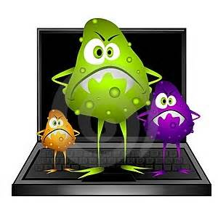
Viruses (2/2)
Well-known viruses
Brain, Michelangelo, Melissa, Love Bug

Slide 34
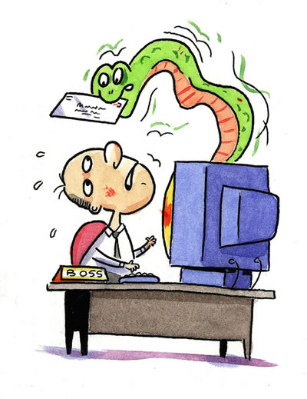
Worms
Worm:
Self-contained program
Spread through a computer network
Exploits security holes in networked computers
Famous worms
WANK, Code Red, Sapphire (Slammer), Blaster, Sasser

Slide 35
CASE: The Internet Worm
Robert Tappan Morris, Jr.
Graduate student at Cornell
Released worm onto Internet from MIT computer
Effect of worm
Spread to 6000 Unix computers
Infected computers kept crashing or became unresponsive
Took a day for fixes to be published
Impact on Morris
Suspended from Cornell
3 years’ probation + 400 hours community service
$150,000 in legal fees and fines

Slide 36
Ethical Evaluation
Kantian evaluation
Morris used others by gaining access to their computers without permission
Social contract theory evaluation
Morris violated property rights of organizations
Utilitarian evaluation
Benefits: Organizations learned of security flaws
Harms: Time spent by those fighting worm, unavailable computers, disrupted network traffic, Morris’s punishments
Morris was wrong to have release the Internet worm

Slide 37
Trojan Horses
Trojan horse:
program with benign capability that conceals a sinister purpose
Examples
Opening an Internet connection to allow an outsider to gain access to files
Logging the keystrokes of a user and storing them on a file that an attacker can peruse to learn confidential information such as passwords
Looking for passwords stored and emailing them to the attacker’s address

Slide 38
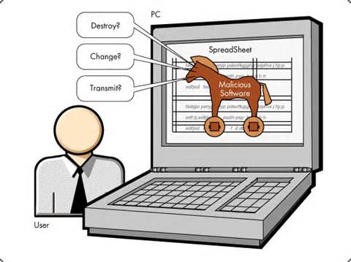
Trojan Horses
Examples
Destroying files
Launching a denial-of-service attack on a web site
Turning the user’s computer into a proxy server that can be used to launch spam or stash information gained from illegal activities

Slide 39
Trojan Horses
Remote access Trojan:
Trojan horse that gives attack access to victim’s computer
Back Orifice
SubSeven
RAT servers often found within files downloaded from erotica/porn Usenet sites

Slide 40
Defensive Measures
Systems administrators play key role
Authentication: determine/verify that people are who they claim to be
Authorization: determine that a user has permission to perform a particular action/Level of access
Firewall: a computer monitoring packets entering and leaving a local area network

Slide 41
Attacks
Denial-of-service-(DoS) is an attempt to make a computer resource unavailable to its intended users
Syn-flood-attack-A SYN flood is a form of DoS in which an attacker sends a succession of SYN requests to a target's system.
The smurf attack: named after its exploit program, is a DoS that uses spoofed broadcast ping messages to flood a target system.

Slide 42
Denial-of-Service Attacks
Denial-of-service attack: an intentional action designed to prevent legitimate users from making use of a computer service
Goal of attack: disrupt a server’s ability to respond to its clients
About 4,000 web sites attacked each week
Asymmetrical attack that may prove popular with terrorists
“Asymmetrical attack “ is type of attacks that can be executed with limited resources against a large, sophisticated site.
For example, an attacker with an old PC and a slow modem may be able to disable much faster and more sophisticated machines or networks.

Slide 43
Attacks that Consume Scarce Resources
SYN flood attack
the attacker begins the process of establishing a connection to the victim machine, but does it in such a way as to prevent the ultimate completion of the connection.
Smurf attack
Fill target computer’s hard disk
Email bombing
Worm
Break-in followed by file copying

Slide 44
Distributed Denial-of-Service Attacks
Attacker gains access to thousands of computers
Launches simultaneous attack on target servers
Defensive measures
Secure computers to prevent hijacking
Check for forged IP addresses

Slide 45
Defensive Measures
Physical security of server
Server is protected by backup and offsite data storage, Uninterruptible Power Supply (UPS), cooling and electrical capacity etc.
Benchmarking
Disk quota systems
allows system administrators to control the number of files and data blocks that can be allocated to users or groups.
Disabling unused network services
Turning off routers’ amplifier network capability

Slide 46
Penalties for Hacking (the Law)
It is a crime to access, alter, damage, or destroy information on a computer without authorization
Examples of illegal activities
Accessing without authorization any internet computer
Transmitting a virus or worm
Trafficking in computer passwords
Intercepting a telephone conversation, email, or any other data transmission
Accessing stored email messages without authorization
Adopting another identity to carry out illegal activity
Maximum penalty: 20 years in prison + $250,000 fine

Slide 47
Catching Hackers
Requires law enforcement to recognize and respond to myriad hacking attacks
Cyber laws – laws relating to protect the internet and other online communication technologies. -Digital Signature Act 1997. -Telemedicine Act 1997. -Communication and Multimedia Act 1998. -Computer Crime Act 1997.
Computer forensics tools may include:
Undercover agents
Honey pots
Archives of online message boards
Tools for recovering deleted or coded information

Slide 48
Security countermeasure
Establish a security policy
Defines the security requirements of an organization and describes the controls and sanctions to be used to meet those requirements
The delineation of the responsibilities and expected behavior of members of the organization
Outlines what needs to be done
Example:
Password must be changed every 30 days
No executable file attachments

Slide 49
Security countermeasure
Educate employees, contractors, and part-time workers
Guarding their passwords to protect against unauthorized access to their accounts
Not allowing others to use their passwords
Applying strict access controls to protect data from disclosure or destruction
Reporting all unusual activity
Better system design
Security as one of the non-functional requirement

Slide 50
Security countermeasures
Firewall technology
A system or combination of systems that enforces a boundary between two or more networks
Filters and gateways are designed to secure communication traffic entering or leaving a specific network domain
Help secures systems from unauthorized access to information in databases
Help prevent unwanted and unauthorized communication into and out of a privately owned network

Slide 51
Security countermeasures
Antivirus software
To “inoculate” computer systems against virus, worms, and other forms of malicious programs
Able to detect and eliminate viruses
Can repair infected files
Can remove infected sectors
Consistently update antivirus

Slide 52
Security countermeasures
Safeguards against malicious insiders
Prompt deletion of accounts, login ids, and passwords of departing employee
Carefully defines roles of employees: separation of responsibility so that a single individual is not responsible to accomplish a high security task
Frequently rotate people in sensitive positions
Creates roles and user accounts to authorize the responsibility and no more
Audit trail

Slide 53
Security countermeasures
Address the top ten most critical internet security threats
Look for them at www.sans.org/top20/2000/ (system admin network security
periodic IT security audit
Evaluate whether a well-thought-out security policy in place and if it is followed
Resulted in a list of items to be corrected

Slide 54
Security countermeasures
Intrusion detection systems
Monitors systems and network resources and activities and, using information gathered, notifies authority
Two approaches
Knowledge-based
Contains info about specific attacks and system vulnerabilities and watch and watch for attempt to exploit these vulnerabilities
Example: repeated login failures, attempting to download a program to a server

Slide 55
Security countermeasures
Intrusion detection systems
2. Behavior-based
Develop a model of normal behavior of the system and its users
Compare current activity to this model and generate an alarm if a deviation is observed
Example
Unusual traffic at odd hours, a user from different department is accessing an accounting system

Slide 56
Security countermeasures
Honeypot
To provide would-be hackers with fake information about network by means of a decoy server to confuse them, trace them, or keep a record for prosecution
Is well-isolated from the rest of the network and is capable of extensively logging the activities of intruders

Slide 57
Security countermeasures
Encryption tools
Cryptography
Is the making and breaking of secret codes; the art and science of hiding data in plain sight
To transform (encryption) a message or data (called plaintext) into a form that is meaningless (called ciphertext) to anyone who might intercept it
The recipient of the ciphertext decodes (decryption) and reads the plaintext

Slide 58
Security countermeasures
Symmetric encryption
A single key is needed to encrypt and decrypt a message
Both sender and recipient must know the key
The key must be secure
Public key cryptography
There are two mathematically related keys; one for encryption and the other for decryption
Each person has a pair of keys; encryption key is public key and decryption key is private key
Public key can be made available in directories so that anyone want send message can use the recipient’s public key

Slide 59
Uses of Encryption
Protecting communications from unauthorized access
Protecting data in transit from unauthorized access
Protecting stored data from unauthorized access
Authentication
Digital cash and micropayment system
Protection of intellectual property in electronic form from copyright infringement

Slide 60

Challenges in the cyber environment
1. Globalization
Differences in provisions on laws and jurisdiction
Differences in culture, religion, social values across countries
Access to content across borders
2. Enforcement Process
Unidentifiable/not traceable suspects
Offender overseas – process to extradite accused is complicated and costly
Foreign based websites/operators not subjected to Malaysian laws & jurisdictions of LEAs
3. Technology capabilities
Increasing usage of media and communications medium
Fast changing technology
4. Consumer empowerment
Consumers not as careful online as they are offline
Still some reluctance on users’ part to take own action (which includes reporting to web administrator or filing civil action)
Low levels of legal literacy

Slide 61
CONCLUSION
Responsible net citizens
Cooperation –
To develop better relationship with all relevant bodies
Education & Awareness –
To educate the public to use the Internet wisely and promote positive and safe usage of the Internet
Legal and Regulatory Frameworks –
Regular review of the laws, regulations and facilities to ensure fair & equitable protection

